Slide 1
Data Modelling
Module-II

Slide 2
Module II: Data Modeling
Data Models,
Categories of Data Model,
Logical Data Modeling
Hierarchical Data Model,
Network Data Model,
Relational Data Model,
Advantages and Disadvantages of Logical Data Modeling.

Slide 3
Module II: Data Modeling
Conceptual Data Modeling:
Entity Relationship Model,
Entities,
Attributes,
Types of Attributes,
Relationships,
Relationship set,

Slide 4
Module II: Data Modeling
Mapping Cardinalities,
Keys,
ER Diagram Notations,
Roles Participation:
Total participation
Partial participation,
Strong and Weak Entity Set.

Slide 5
Data Model
Data model is a collection of conceptual tools for describing data, data relationships, data semantics and consistency constraints
Data models define how the logical structure of a database is modeled. Data Models are fundamental entities to introduce abstraction in a DBMS. Data models define how data is connected to each other and how they are processed and stored inside the system.

Slide 6
Why Use Models?
Models can be useful when we want to examine or manage part of the real world
The costs of using a model are often considerably lower than the costs of using or experimenting with the real world itself
Examples:
Airplane simulator
Nuclear power plant simulator
Flood warning system
Model of US economy
Model of a heat reservoir
Map

Slide 7
A Map Is a Model of Reality

Slide 8
Data Modeling
DATABASE SYSTEM
REALITY
structures
processes
MODEL
data modeling
The model represents a perception of structures of reality
The data modeling process is to fix a perception of structures of reality and represent this perception
In the data modeling process we select aspects and we abstract

Slide 9
Type of Data Models
Hierarchical Model
Network Model
Relational Model

Slide 10
Hierarchical Model

Slide 11
Hierarchical Model
It is one of the oldest data models, dating from late 1950s.
Information System Management(IMS) was the first hierarchical database developed jointly by IBM & North American Rock Well Company.
Hierarchical model Organizes data element as tabular rows.

Slide 12
The heirarchy starts from the Root data, and expands like a tree, adding child nodes to the parent nodes.
In this model, a child node will only have a single parent node.
This model efficiently describes many real-world relationships like index of a book, recipes etc.
In hierarchical model, data is organised into tree-like structure with one one-to-many relationship between two different types of data, for example, one department can have many courses, many professors and of-course many students.

Slide 13
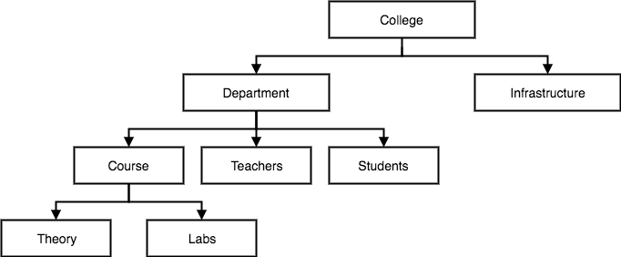
Example of Hierarchical Model

Slide 14
Advantages
Hierarchical Model has many advantages over the file systems.
Simplicity:-since the database is based on the hierarchical structure, the relationship between the various layers is logically simple. Thus design of hierarchical database is simple.
Data Security:-it was the first database model that offered the data security, is provided and enforced by the DBMS.
Data Integrity:-because it is based on parent child relationship, so there is always a link between parent and child segment.

Slide 15
Advantage
Efficiency:-it is very efficient one when it contains a large number of 1:M relationships and when user require large number of transactions.

Slide 16
Disadvantages
Main disadvantages of hierarchical model are
Implementation Complexity:-although it is very simple conceptually and easy to design but it is quite complex to implement. because it require good knowledge of physical storage.
Database Management Problem:-if you make any changes in hierarchical database, then you need to make necessary changes in all application, that access the database.
Lack of structural Independence:-Hierarchical database system uses physical path to navigate different data segment. So if physical structure is changed, then we need to make necessary changes in the application program also.

Slide 17
Network Model
Its inventor was Charles Bachman
The popularity of the network data model coincided with the popularity of the hierarchical data model.
Some data were more naturally modeled with more than one parent per child. So, the network model permitted the modeling of many-to-many relationships in data.
In 1971, the Conference on Data Systems Languages (CODASYL) formally defined the network model.

Slide 18
Network Model………..
The basic data modeling construct in the network model is the set construct. A set consists of an owner record type, a set name, and a member record type.
A member record type can have that role in more than one set; hence the multi parent concept is supported. An owner record type can also be a member or owner in another set.

Slide 19
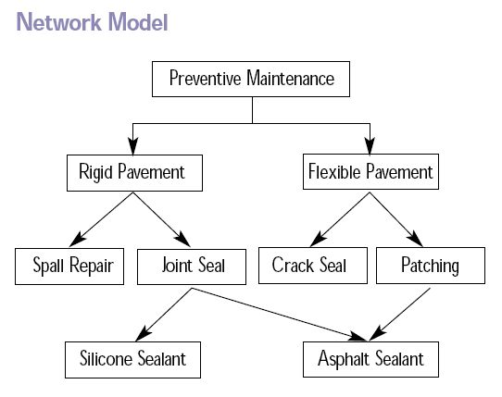
Network Model

Slide 20
Some Well-known Network Databases
Digital Equipment Corporation DBMS-10
Digital Equipment Corporation DBMS-20
Digital Equipment Corporation VAX DBMS
Honeywell IDS (Integrated Data Store)
IDMS (Integrated Database Management System)
Oracle CODASYL DBMS
Raima Data Manager (RDM) Embedded
RDM Server
Turbo IMAGE
Univac DMS-1100

Slide 21
Advantages of Network Model
It as simple as hierarchical model.
It handles more relationship type as M: N and multi parent.
Data access is more flexible that hierarchical model.
Data owner /membership promote data integrity.
It includes DDL and DML in DBMS.

Slide 22
Disadvantages of Network Model
System complexity limits efficiency.
Navigation system yields complex implementation, application, development and management.
Structural changes require changes in all application programs.

Slide 23
Relational Model
(RDBMS - relational database management system) A database based on the relational model developed by E.F. Codd.
A relational database allows the definition of data structures, storage and retrieval operations and integrity constraints.
In such a database the data and relations between them are organized in tables.
A table is a collection of records and each record in a table contains the same fields.

Slide 24
Properties of Relational Tables
Values Are Atomic
Each Row is Unique
Column Values Are of the Same Kind
The Sequence of Columns is Insignificant
The Sequence of Rows is Insignificant
Each Column Has a Unique Name

Slide 25
Tables − In relational data model, relations are saved in the format of Tables. This format stores the relation among entities. A table has rows and columns, where rows represents records and columns represent the attributes.
Tuple − A single row of a table, which contains a single record for that relation is called a tuple.

Slide 26
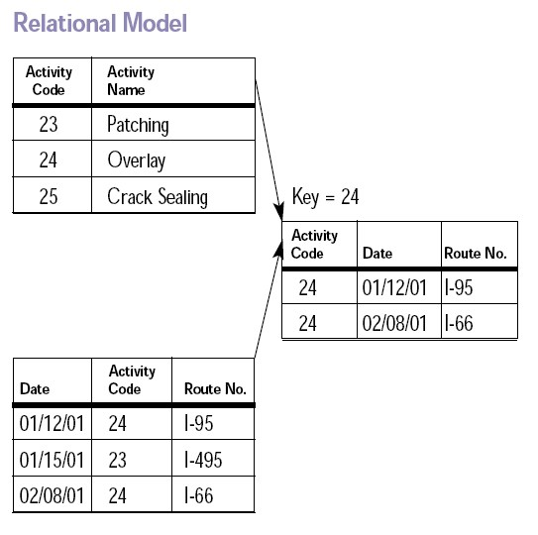
Relational Model

Slide 27
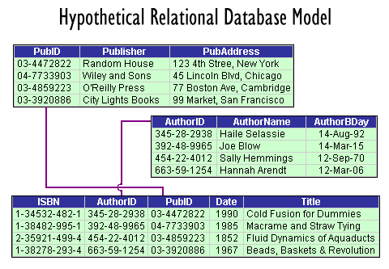

Slide 28
Advantage Of Relational Model
Structural independence in promoted by the use of independent tables. Changes in data structure do not affect data access or application program.
Tabular view improves conceptual simplicity, thereby promoting easier database design, implementation, use and maintenance.
Ad hoc query capability is based on SQL.

Slide 29
Disadvantages of Relational Model
RDBMS requires substantial hardware, system software expenses.
Conceptual simplicity gives relatively untrained people, a tool to use good system poorly.

Slide 30
Entity Relationship Diagrams
Basic Elements and Rules

Slide 31
Introduction to Entity-Relationship (E-R) Modeling
Entity-Relationship (E-R) Diagram
A detailed, logical representation of the entities, associations and data elements for an organization or business.
Notation uses three main constructs
Data entities
Relationships
Attributes
10.31

Slide 32
Entity-Relationship (E-R) Modeling Key Terms
Entity
A person, place, object, event or concept in the user environment about which the organization wishes to maintain data
Represented by a rectangle in E-R diagrams
Entity Type
A collection of entities that share common properties or characteristics
Attribute
A named property or characteristic of an entity that is of interest to an organization
10.32

Slide 33
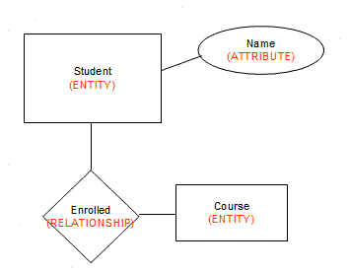

Slide 34
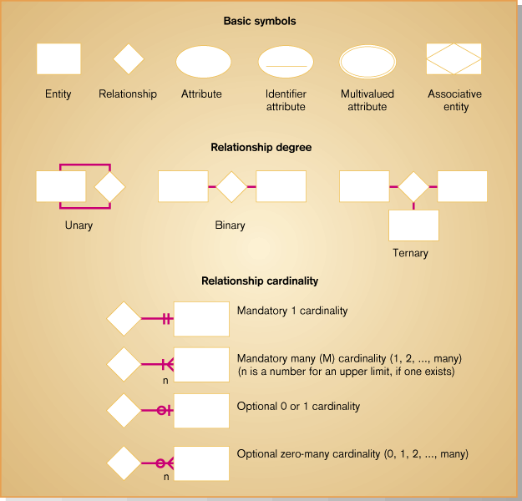
Depicting Entities and Attributes

Slide 35
Type of Attribute
Simple Attribute & Composite Attribute
Single Valued Attribute &Multi Valued Attribute
Stored Attribute & Derived Attributes
Complex Attribute
Key Attribute

Slide 36
Simple and Composite Attribute
Simple attribute that consist of a single atomic value. A simple attribute cannot be subdivided. Example :age, sex etc are simple attributes.
A composite attribute can be further subdivided. It consists of Non-atomic values. Example ADDRESS can be subdivided into street, city, state, and zip code.
Address
House no:
City:
State:
Name :
First Name:
Middle Name:
Last Name’

Slide 37
Single Valued and Multi Valued attribute
Single Valued attribute can have only a single value OR can hold single values.
It can be simple or composite attribute
Example a person can have only one 'date of birth', ‘Age' etc..
'date of birth' is a composite attribute ,
'age' is a simple attribute.
But both are single valued attributes.
Example1: Age Exampe2: City Example3:Customer id

Slide 38
Single Valued and Multi Valued attribute
Multivalued attributes can have multiple values.
For instance a person may have multiple phone numbers, multiple degrees etc.
Multi Valued Attribute: Attribute that hold multiple values.
Example1: A customer can have multiple phone numbers, email id's etc.
Example2: A person may have several college degrees

Slide 39
Stored and Derived Attributes
Stored attribute: supplies a value to the related attribute.
Example: 'Date of birth' of a person is a stored attribute.
The value for the attribute 'AGE' can be derived by subtracting the 'Date of Birth'(DOB) from the current date.
Derived Attribute: An attribute that’s value is derived from a stored attribute.
Example : age, and it’s value is derived from the stored attribute “Date of Birth. “

Slide 40
Complex Attribute
Complex Attribute
A complex attribute that is both composite and multi valued.

Slide 41

Key attribute
A key attribute is the unique, distinguishing characteristic of the entity. For example, an employee's social security number might be the key attribute.

Slide 42
Relationships
Relationship:- Describes association among entities .
Example:- relationship between customer and agent can be described as follows.
an agent can serve many customer
a customer can be served by one agent.
There are three type relationship.
One To One.
One To Many.
Many To Many.

Slide 43
Entity-Relationship (E-R) Modeling Key Terms
Candidate keys and identifiers
Each entity type must have an attribute or set of attributes that distinguishes one instance from other instances of the same type
Candidate key
Attribute (or combination of attributes) that uniquely identifies each instance of an entity type

Slide 44
One-to-Many Relationship(1:M):-A painter paints many different paintings , but each one of them is painted by only one painter. Thus PAINTER (one)is related to the PAINTING(many).
Many-to-Many Relationship(M:M):- an employee may learn many job skills, and each job SKILL may be leaned by many EMPLOYEE .
One to One relationship(1:1):-one employee is managing one store means store MANAGER (one)manages STORE(one).

Slide 45
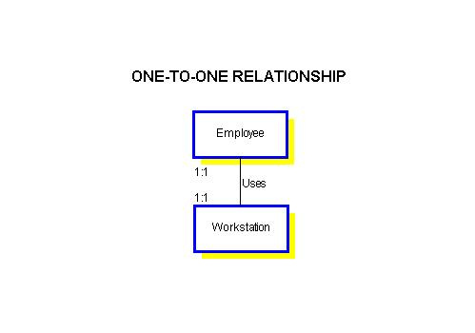

Slide 46
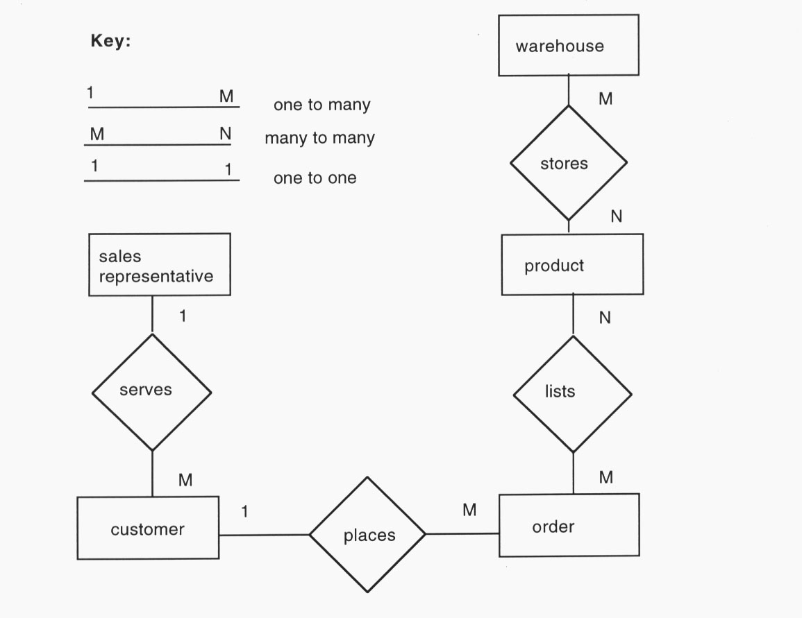

Slide 47
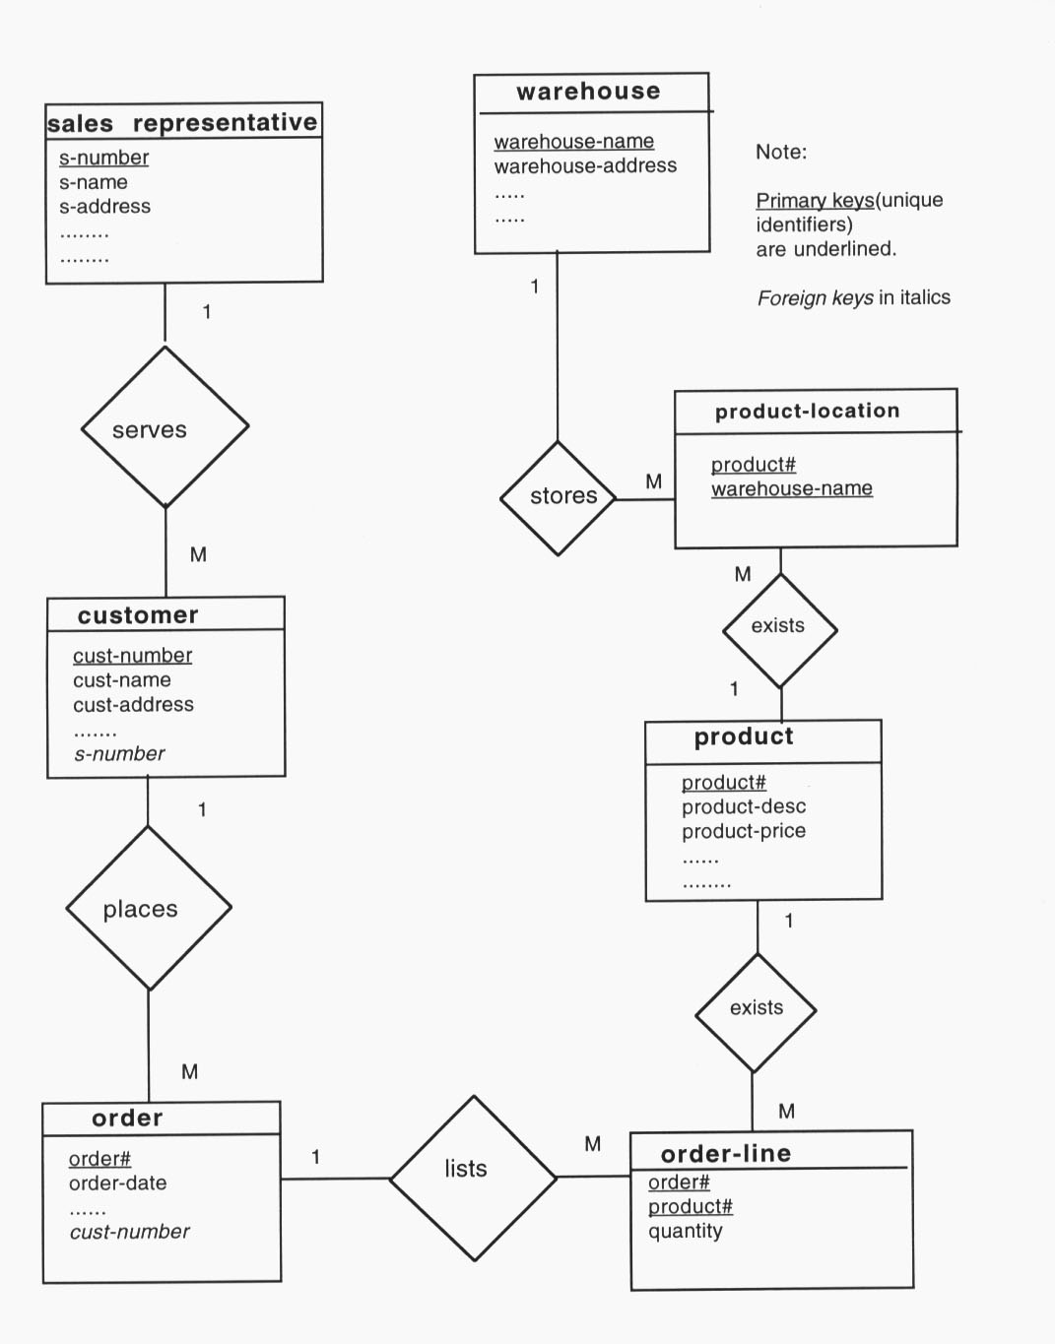

Slide 48
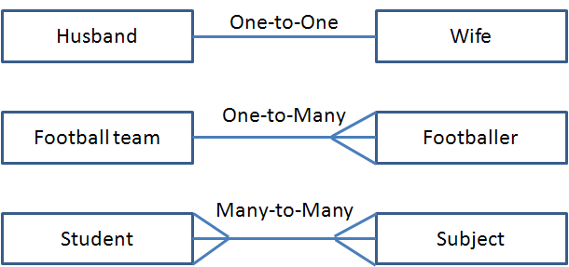

Slide 49
Domain
A domain is a set of valid atomic values that an attribute can take. Within a single database, an attribute cannot have different domains associated with it. A domain can include a null value, if the value for the domain is unknown or does not exist.

Slide 50
A domain is a unique set of values permitted for an attribute in a table. For example, a domain of month-of-year can accept January, February….December as possible values, a domain of integers can accept whole numbers that are negative, positive and zero.

Slide 51
Domain
A domain defines the possible values of an attribute.
Domain Integrity rules govern these values.
In a database system, the domain integrity is defined by:
The data type and the length
The NULL value acceptance
The allowable values, through techniques like constraints or rules
The default value

Slide 52
Example of Domain
if you define the attribute of Age, of an Employee entity, is an integer, the value of every instance of that attribute must always be numeric and an integer.
If you also define that this attribute must always be positive, the negative value is forbidden.
The value of this attribute being mandatory indicates that the attribute can not be NULL.
All of these characteristics form the domain integrity of this attribute.

Slide 53
Domain information of an attribute includes
Data Type - Basic data types are integer, decimal, or character. Most data bases support variants of these plus special data types for date and time.
Length - This is the number of digits or characters in the value. For example, a value of 5 digits or 40 characters.
Date Format - The format for date values such as dd/mm/yy or mm/dd/yyyy or yy/mm/dd.
Range - The range specifies the lower and upper boundaries of the values the attribute may legally have.

Slide 54
Domain information of an attribute includes
Constraints - Are special restrictions on allowable values. For example, the Leaving Date for an Employee must always be greater than the Hire Date for that Employee.
Null support - Indicates whether the attribute can have null values.
Default value (if any) - The value an attribute instance will have if a value is not entered.

Slide 55
Tuple & attribute Cardinality & degree

Slide 56
Tuple
A row in a table is called a tuple of the relation.
The number of tuples in a relation is known as the cardinality of the relation.
Tuples in a table are unique and can be arranged in any order.

Slide 57
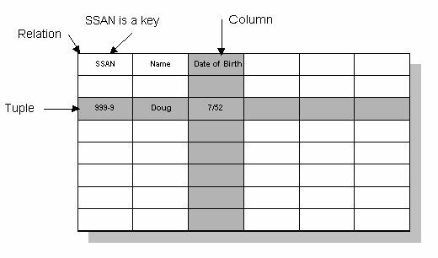

Slide 58
Attribute
Each attribute of a relation stores a piece of information about an object.
Attributes are represented as columns in a tables and can be arranged in any order.
Each attribute in a relation is unique and contain atomic values
i.e. Atomic value contain a single value of data and Non-Atomic values contain a set of values.
The number of attributes in a relation is called the degree of the relation.
ERD for School Management System
an ERD for Bus Reservation System

Slide 59
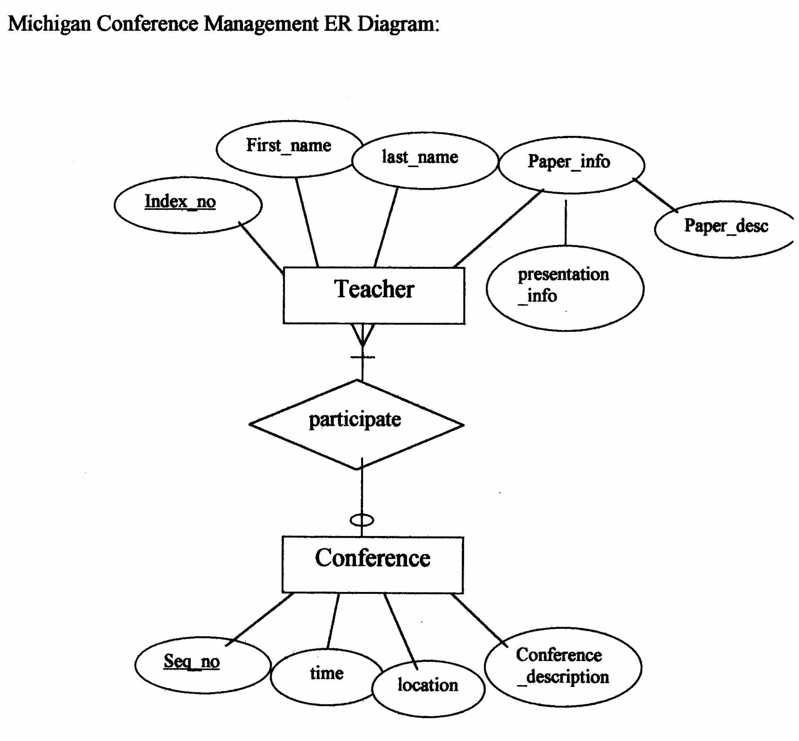

Slide 60
Keys
Superkey: an attribute or set of attributes that uniquely identifies an entity--there can be many of these
Composite key: a key requiring more than one attribute
Candidate key: a superkey such that no proper subset of its attributes is also a superkey (minimal superkey – has no unnecessary attributes)

Slide 61
Keys
Primary key: the candidate key chosen to be used for identifying entities and accessing records. Unless otherwise noted "key" means "primary key"
Alternate key: a candidate key not used for primary key
Secondary key: attribute or set of attributes commonly used for accessing records, but not necessarily unique

Slide 62
keys
Foreign key: term used in relational databases (but not in the E-R model)
for an attribute that is the primary key of another table and is used to establish a relationship with that table where it appears as an attribute also.

Slide 63
Roles
The role of a relationship type names one of the related entities. The name of the entity is usually the role name.
Entity sets of a relationship need not be distinct
The labels “manager” and “worker” are called roles; they specify how employee entities interact via the works-for relationship set.
Roles are indicated in E-R diagrams by labeling the lines that connect diamonds to rectangles.
Role labels are optional, and are used to clarify semantics of the relationship

Slide 64
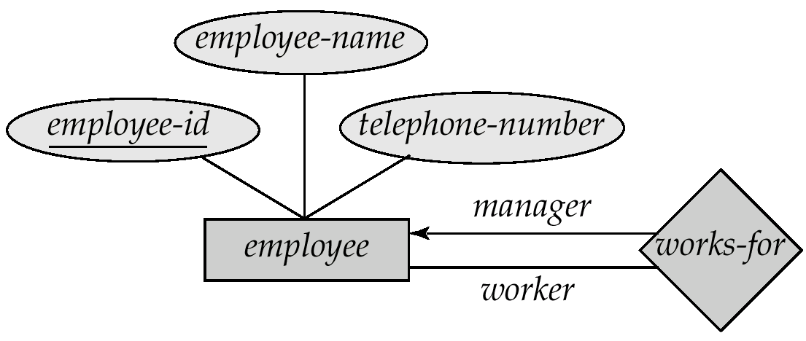
Roles participation
A role can participate in a relation.
Total participation
Partial participation

Slide 65
Total participation
Every member of entity set must participate in the relationship
Represented by double line from entity rectangle to relationship diamond
E.g. A Class entity cannot exist unless related to a Faculty member entity .

Slide 66
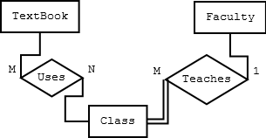

Slide 67
Partial participation
Not every entity instance participate
Represented by single line from entity rectangle to relationship diamond
E.g., A Textbook entity can exist without being related to a Class or vice versa.

Slide 69
Entity Type
set of similar objects or a category of entities; they are well defined
A rectangle represents an entity set
Ex: students, courses
We often just say "entity" and mean "entity type"

Slide 70
Entity type
Entity can be of two type
Strong Entity
Weak Entity

Slide 71
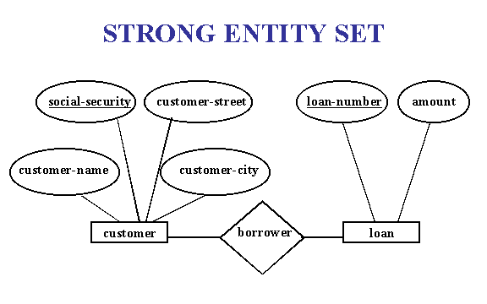
Strong entity set
An entity set that have a primary key is referred to as a strong entity set.

Slide 72
Weak Entity
a weak entity is an entity that cannot be uniquely identified by its attributes alone; therefore, it must use a foreign key in conjunction with its attributes to create a primary key.

Slide 73
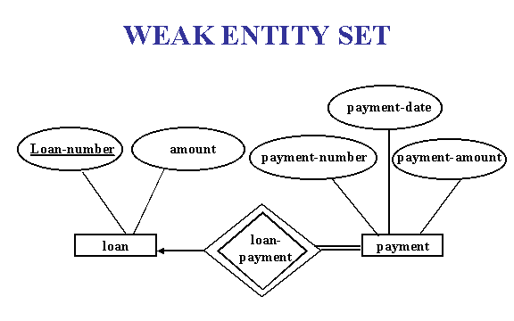

Slide 74
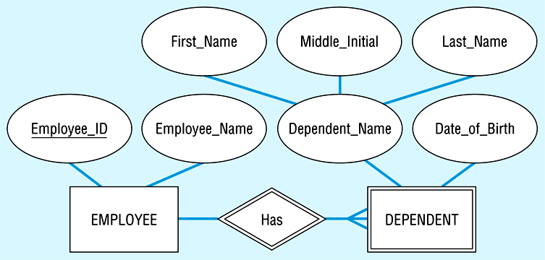
Example of Weak entity

Slide 75
